Slide 1

Basics of Web Design
Fifth Edition
Chapter 12
Web Publishing Basics Key Concepts
Slide in this Presentation Contain Hyperlinks. JAWS users should be able to get a list of links by using INSERT+F7
Copyright © 2019 Pearson Education, Inc. All Rights Reserved
Notes:
If this PowerPoint presentation contains mathematical equations, you may need to check that your computer has the following installed:
1) Math Type Plugin
2) Math Player (free versions available)
3) NVDA Reader (free versions available)

Slide 2
Learning Outcomes
File Organization - Code relative hyperlinks to web pages in folders within a website
Targeting Hyperlinks - Configure a hyperlink to a named fragment internal to a web page
Describe criteria to consider when selecting a web host
Obtain a domain name for your website
Publish a website using F T P
Design web pages that are friendly to search engines
Submit a website for inclusion in a search engine
Describe S S L
Determine if a website meets accessibility requirements
Evaluate the usability of a website

Slide 3
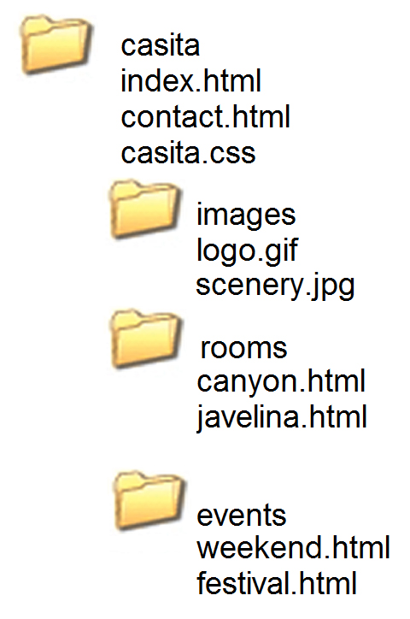
File Organization
Relative links from the canyon.html page in the rooms folder
<a href="javelina.html">Javelina</a>
<a href="../index.html">Home</a>
<a href="../events/weekend.html">Weekend Events</a>

Slide 4
Targeting a Hyperlink: Link to a Fragment Identifier
A link to a part of a web page
Also called named fragments, fragment ids
Two components:
The element that identifies the named fragment of a Web page. This requires the id attribute.
<div id="top"> ….. </div>
The anchor tag that links to the named fragment of a Web page. This uses the href attribute.
<a href="#top">Back to Top</a>
Note the use of the # in the anchor tag!

Slide 5
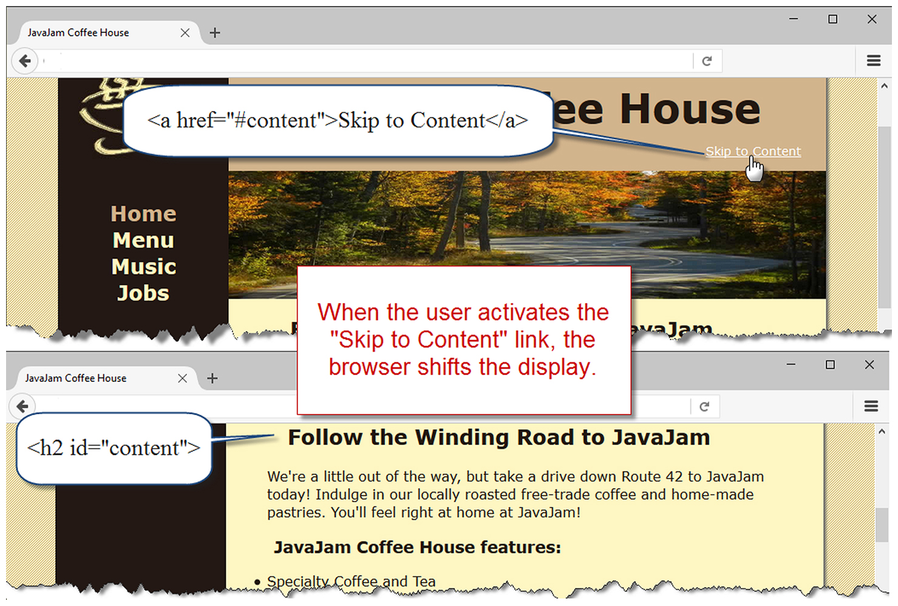
Skip to Content

Slide 6
Domain Names
Establishes a Web presence for your business/ organization
New Business
choose domain name while selecting company name
Established Business
choose a domain name that relates to your established business presence

Slide 7
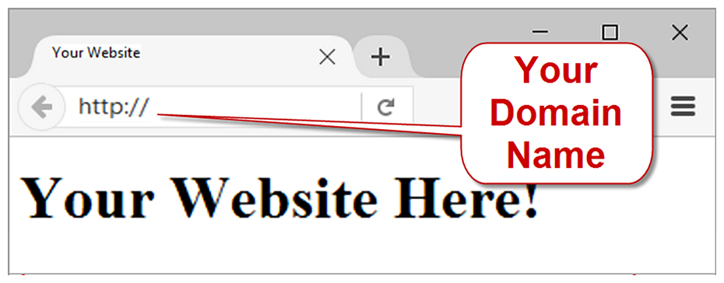
Choosing a Domain Name
Describe your business
Be brief, if possible
Avoid hyphens
T L D (top level domain name)
.com, .net, .biz, .us, .mobi and others
.org for non-profits
Brainstorm potential keywords
Avoid trademarked words or phrases
Know the territory (use Google!)
Verify Availability

Slide 8
Registering a Domain Name
There are many domain name registrars, including
http://register.com
http://networksolutions.com
http://godaddy.com
Visit Registrar, choose name, pay with credit card or Paypal
Private registration – additional fee but personal information is kept private and out of the W H O I S database

Slide 9
Web Hosting
Some organizations administer a web server in-house and host their own web site.
Most companies use a web host provider.
A good web hosting service will provide a robust, reliable home for your web site.
A poor web hosting service will be the source of problems and complaints.
Do not use free web hosting for a commercial web site.

Slide 10
Types of Web Hosting
Hosting Needs: Small to Medium Website
Virtual Hosting
The web host provider's server is divided into a number of virtual domains and multiple websites are set up on the same computer.
Hosting Needs: Large to Enterprise Web Site
Dedicated Web Server
Co-located Web Server
Consider:
National web host providers
Guaranteed uptime – service level agreement (S L A)
Bandwidth of Internet connection
Technical Support

Slide 11
Choosing a Virtual Host
See the Web Host Checklist
Operating System
Web Server Software
Bandwidth
Technical Support
Service Agreement
Disk Space
E-mail
Uploading Files
Canned Scripts
Scripting Support
Database Support
S S L Support
E-Commerce Packages
Scalability
Backups
Site Statistics
Domain Name
Price

Slide 12
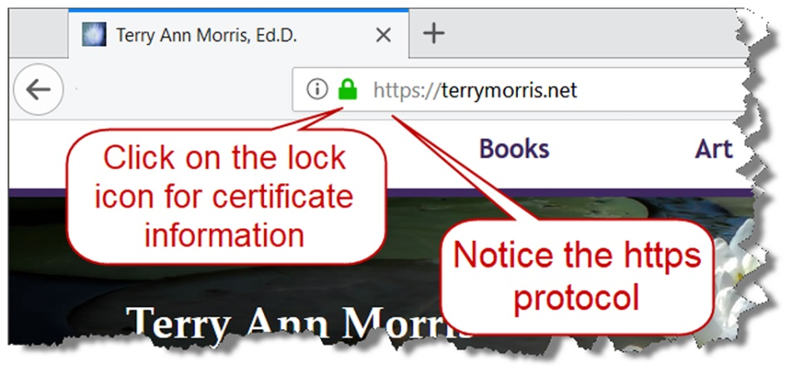
Secure Sockets Layer (S S L)
A protocol that allows data to be privately exchanged over public networks
Developed by Netscape
Encrypts data sent between a client (usually a Web browser) and a Web server.
Utilizes both symmetric and asymmetric keys.
“https” protocol
Browsers display a “lock” icon

Slide 13
Digital Certificate
The contents of a digital certificate include:
The public key
Effective date of the certificate
Expiration date of the certificate
Details about the Certificate Authority -- the issuer of the certificate
Details about the certificate holder
A digest of the certificate content

Slide 14
Publish with F T P
F T P, File Transfer Protocol
F T P is utilized to copy and manage files and folders over the Internet
Popular F T P Applications
Filezilla
SmartF T P
CuteF T P
W S_F T P

Slide 15
Popular Search Engines
Google, Bing, Baidu, and Yahoo!— the four most popular sites used for searching the Web during a recent month.

Slide 16
Search Engine Robot
Also called a spider or bot
A computer program that follows hyperlinks and “walks” the Web – accessing and documenting Web pages.
Categorizes the pages and stores information in a database.
May access the following components of web pages:
title,
description meta tag
text in headings
other text on the page
hyperlinks

Slide 17
Search Engine Database
Database:
A collection of information organized so that its contents can easily be accessed, managed, and updated.
Database Management Systems (D B M S s)
Configure and manage database
Oracle, MyS Q L, Microsoft S Q L Server, I B M D B2
Search Engine Database
Contains information about web pages

Slide 18
Search Engine Search Form
The part you are most familiar with!
The search form is the graphical user interface that allows a user to request a word or phrase to search for.
The visitor to the search engine types words (called keywords) related to their search into the text box.
When the form is submitted, the data typed into the text box is sent to server-side processing that searches the database using the keywords you have entered.
The search results (also called a result set) is a list that contains information such as the U R Ls for web pages that meet your criteria.

Slide 19
Search Engine Results Page (S E R P)
A list of items that describe web pages matching the search terms.
Each item contains a link to a page along with additional information that might include the page title, a brief description, the first few lines of text, the size of the page, and so on.
The order the web page items are displayed in the S E R P may depend on:
paid advertisements
alphabetical order
link popularity
Each search engine has their own policy for ordering the search results.

Slide 20
C S S Drop Down Menu
The meta element
A stand-alone tag
Placed in the head section
Attributes:
name
content
<meta name="value" content="value">
Meta tag used by search engines:
name="description"

Slide 21
Keywords Meta Tag
Example: “Acme Design”
<meta name="description" content="Acme Design, a premier web consulting group that specializes in E-commerce, web site design, web site development, and web site re-design." >

Slide 22
Search Engine Optimization (S E O) (1 of 3)
Determine keywords
Page Title
Include the company and/or website name
Include selected keywords as appropriate
Heading tags
Include keywords
Text on page includes keywords

Slide 23
Search Engine Optimization (S E O) (2 of 3)
Linking
Provide text navigation hyperlinks
Verify that all hyperlinks are functioning
Page Layout
Avoid nested tables
Use C S S for page layout
Images & Multimedia
Configure meaningful alternate text
Be aware that text and hyperlinks contained within multimedia may not be accessed by search engine robots

Slide 24
Search Engine Optimization (S E O) (3 of 3)
Valid Code
Validate H T M L
Validate C S S
Content of Value
Follow Web Design Best Practices
Well-organized
Meaningful & useful to your target audience

Slide 25
Listing in a Search Engine
Wait until your site is finished
Apply S E O techniques
Don’t submit “under construction” websites!
Visit Search Engine and look for “Add U R L” or “Suggest U R L”, or “Add your Site”, etc.
Follow the directions and fill out the form
A robot from the search engine will visit your Web site and index it
Allow several weeks and test the search engine to see if your site is listed

Slide 26
Link Popularity
A rating determined by a search engine based on:
the number of sites that link to a particular website
the quality of the sites that the links are from
The link popularity of your website can help determine its order in the S E R P

Slide 27
Accessibility Testing
Universal Design & Accessibility
Web Accessibility Standards
Section 508
W C A G 2.0, W C A G 2.1
Testing for Accessibility Compliance
Automated Accessibility Testing
Manual Accessibility Testing

Slide 28
Usability Testing
Usability
the measure of the quality of a user's experience when interacting with a website
Usability Testing
Testing how actual web page visitors use a website
Can be done at almost any stage of development
Early – use paper and sketches of pages
Design – use prototype
Production & Testing – use actual pages

Slide 29
Summary
This chapter introduced you to web publishing topics: choosing a domain name, selecting a web host, and uploading files to a website.
The chapter also provided an overview of search engines, search engine submission, and search engine optimization.
Finally, the chapter provided an overview of testing the accessibility and usability of a website.

Slide 30

Copyright
This work is protected by United States copyright laws and is provided solely for the use of instructors in teaching their courses and assessing student learning. Dissemination or sale of any part of this work (including on the World Wide Web) will destroy the integrity of the work and is not permitted. The work and materials from it should never be made available to students except by instructors using the accompanying text in their classes. All recipients of this work are expected to abide by these restrictions and to honor the intended pedagogical purposes and the needs of other instructors who rely on these materials.

